Slide 1
Object Oriented Programming
A-Level Computer Science

Slide 2

Why OOP?

Slide 3

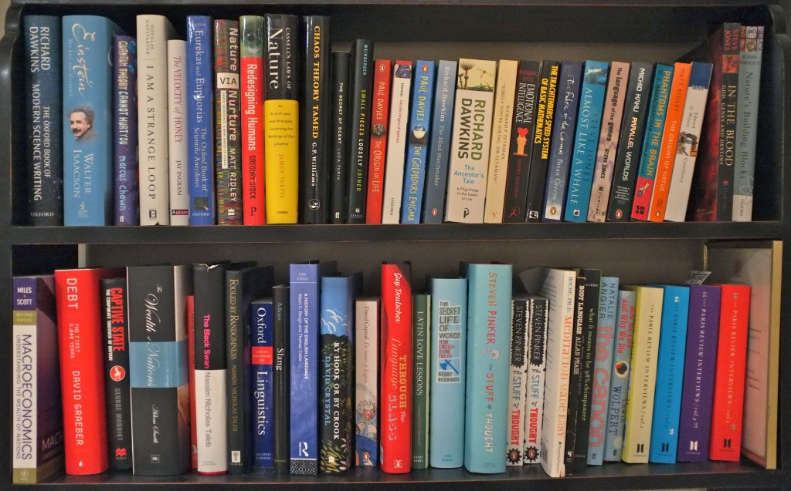

Slide 4
Imperative Approach
Assignment statements are used to change the value in a memory location
Instructions are executed in programmer defined sequence
Values are changed using structured programming approach employing sequence, selection and iteration.
Use of procedures and functions to carry out tasks
Programs are compiled, executed and run to completion

Slide 5
Imperative…Where we started
First programs were like our pile of books
Then we separated tasks into procedures and functions (shelves)
Doesn’t prevent somebody going to a shelf and picking up a book and putting it somewhere else
E.g. Changing a variable in one function which accidently alters another

Slide 6
Problems with Imperative
Programs become complex
Real world problems end up as hundreds of procedures and functions
If data changes in one module but not in another – the results can be a disaster. Tempting to use Global variables in larger programs
Maintaining imperative programs can be difficult

Slide 7
So Why Object Oriented?
OO is a different approach
Procedures and Functions are grouped around related data to construct an Object
Objects are created from classes and a class can be thought of an a blueprint or a master copy of a related group of items. It defines the properites and methods of a group of similar objects.
An instance of a class is called an Object
An object is a collection of data and its corresponding subroutines (methods) that act on that data.

Slide 8
So Why Object Oritented?
An object acts like a black box
Put stuff in
Get stuff out
Not concerned with the inner workings
Objects are considered to be more in line with the way humans see the world which can help the programmer solve problems

Slide 9
So Why Object Oriented?
Reusability!
Once a class has been written, created and debugged it can be re-used in other programs
Re-used without modifying or we can add additional features
New classes can be derived from an existing class (Inheritance)

Slide 10

Objects
Name some properties of a ball
What can you do to or with a ball?
Are there other types of balls?
What do they have in common?
What ways do they differ?

Slide 11
Objects
Task 1 – So what is an Object?
Task 2 – What is a non-Object?

Slide 12

Objects
Objects in the real world:
An Identity (a distinct individual)
A state (properties)
Behaviour (methods … can do stuff or have things done to it)
Identify: Mary’s Tennis Ball
State: Size Colour Radius
Behaviour: Spinning, Bouncing…

Slide 13
Classes & Objects
A class can be thought of as a blue print or a master copy of a related group of items
An Object is an instance of a class
Instantiation is the process of creating an object of the class

Slide 14
Class
What properties and methods would the following classes have?
Human
Car
Dog
Customer

Slide 15
Software Objects
Although not tangible – they can still be created
Let’s think about bank accounts
Identity: Mary’s Bank Account
State: Balance, OverdraftLimit
Behaviour: MakeDeposit CheckBalance MakeWithdrawal

Slide 16
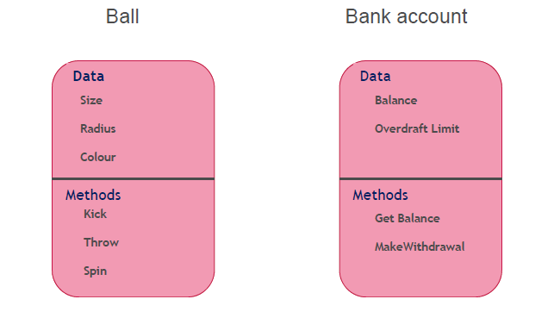
Diagrammatically

Slide 17

Classes
Classes can be thought of as a
Blueprint or a master copy
Gingerbread man
Each created with the same basic features but each can have different characteristics
You can create any number
You can also destroy them Yum Yum!
The cutter can be used again and again

Slide 18
Encapsulation
The concept of grouping data and methods together within the same object is known as Encapsulation
Subroutines act on the data within the object
Key feature of OOP
Objects are self-contained
Overcomes issue of a routine in one procedure overwriting values in another
In OOP the data can only be manipulated directly by the methods from that object.

Slide 19
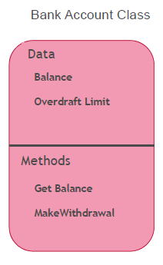
Encapsulation
Information Hiding
Data within an Object can only be accessed or modified by the methods within the Object
Any code outside the class can only access the data through the defined methods.
Going back to our bank account class we can see the data (properties) and methods which acr on it. This means that to withdraw from an account we can only use MakeWithdrawal

Slide 20
Access Modifiers
Properties of a class – declared as Private
Methods (procedures/functions) can be declared as:
Public
Protected
Private
Friend
Class methods declared as Public enable properties of the class to be accessed outside of the class

Slide 21
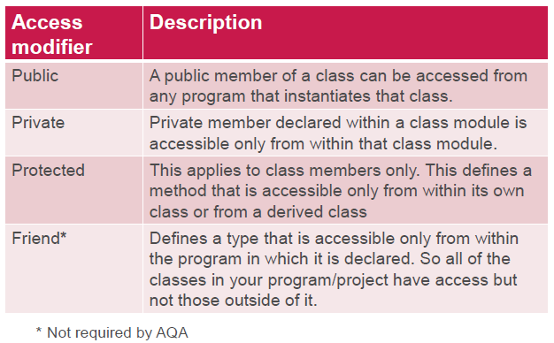

Slide 22
Defining a Class
Name the class
Decide the properties of the class
Declare the properties as Private or Protected
Declare the methods of the class (Procedures/Functions)
Declare the methods as public
Write the code for the methods

Slide 23
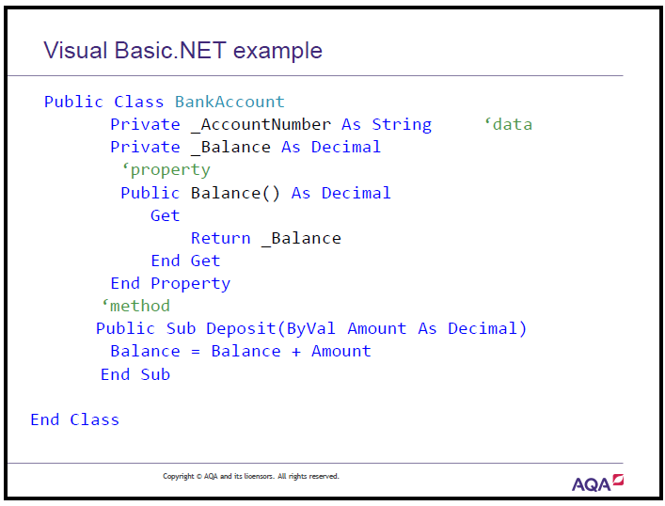

Slide 24
Summary
Properties – Private
Methods – Public
Encapsulation
Information Hiding

Slide 25
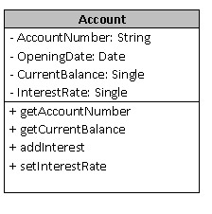
Class Diagram
Use a + or – to indicate visibility of a property or method
+ means method or property is Public
- means methods/property is private
Use a # to indicate it is protected

